Slide 1
Dodgers PD Stat Presentation
Spring Training: 2017

Slide 2
Table of Contents
Hitter Statistics:
K%: 4-5
BB%: 6-7
ISO: 8-9
wOBA: 10-11
wRC+: 12-13
Exit Velo: 14-15
Swing%: 16-17
zSwing%: 18-19
Chase%: 20-21
Contact%: 22-23
GB%: 24-25
PU%: 26-27
Pitcher Statistics:
K%: 33-35
BB%: 36-38
FPS%: 39-40
Zone%: 41-43
Miss%: 44-46
SwStrk%: 47-49
GB%: 50-52
PU%: 53-54
FIP: 55-56
Extension: 57-58
Exit Velocity: 59-60

Slide 3
Hitter Statistics

Slide 4
K%: Strikeout Rate
Description: The percentage of plate appearances that result in a strikeout.
Why it’s Important: A high strikeout rate is worrisome because less contact = less opportunities to get on base. A strikeout, unlike a ball in play, is assured to be a negative outcome, so a batter who strikes out frequently is consistently failing to provide value during those PA. Additionally, a high strikeout rate is indicative of a batter that has a difficult time making contact or recognizing pitches.
Why it Doesn’t Tell Us the Whole Picture: A player can still provide considerable offensive value even with a high strikeout rate. However, that player must excel in other facets of their offensive game for this to be true. The most common way this manifests itself is a player that pairs a K% with a high ISO and high BB%.

Slide 5
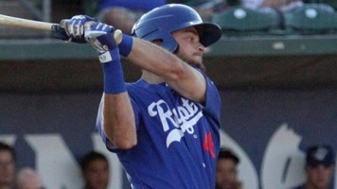
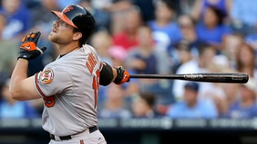
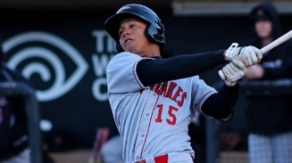
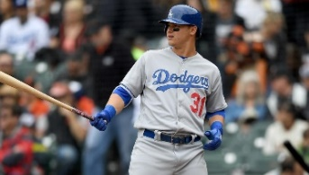
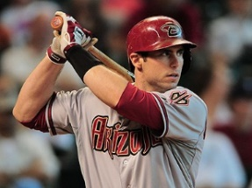
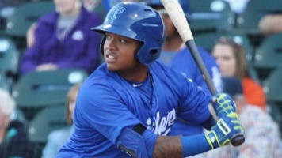
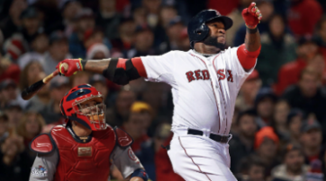
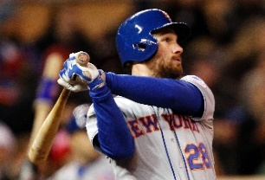
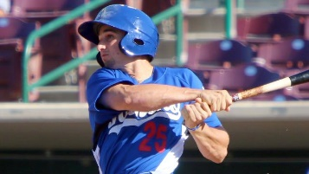
K%: Strikeout Rate
Poor
Poor
Cody Thomas: 35.1% (SA)
Chris Davis: 32.9%
Ariel Sandoval: 28.6% (A+)
Joc Pederson: 27.3%
ML AVERAGE: 21.1%
ML AVERAGE: 21.1%
Paul Goldschmidt: 21.3%
Daniel Murphy: 9.8%
Tim Locastro: 7.7% (AA)
Willie Calhoun: 11.6% (AA)
David Ortiz: 13.7%
Elite
Elite

Slide 6
BB%: Walk Rate
Description: The percentage of plate appearances that result in a walk.
Why it’s Important: High walk rates are good for batters because it means they are reaching base often. Furthermore, a BB means you are reaching base 100% of the time, whereas a ball in play has a high likelihood of being an out (ML Avg BABIP: .300). Generally speaking, a high walk rate is also indicative of a player’s plate discipline and understanding of the strike zone. If a player routinely draws walks, they are likely very good at distinguishing between balls and strikes, which will not only lead to more times on base via a walk, but will also possibly lead them to make better contact because they will be more likely to swing at pitches that they can drive.
Why it Doesn’t Tell Us the Whole Picture: A player can have a low walk rate and still provide offensive value. However, that player must excel in other facets of their offensive game for this to be true. For example, if a player shows an inability to walk at a high rate, they also must demonstrate an ability to slug and/or reach base at a high level via elite contact skills (low K%) or speed.

Slide 7
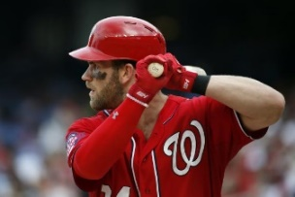
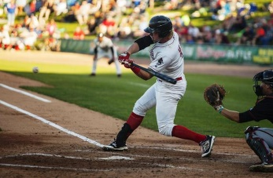

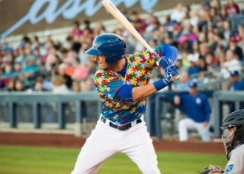
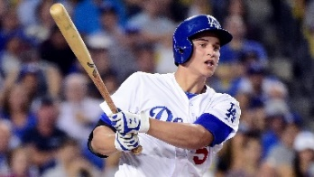
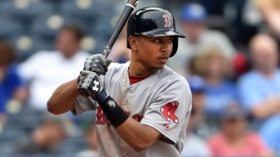
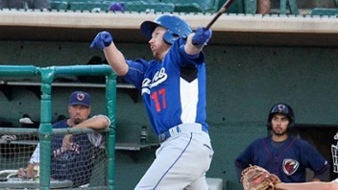
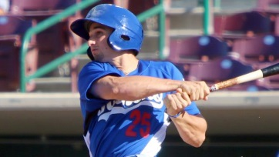
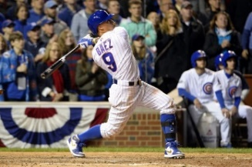
BB%: Walk Rate
Elite
Elite
Bryce Harper: 17.2%
Matt Jones: 14.8% (A)
Joc Pederson: 13.2%
Cody Bellinger: 12.7% (AA)
ML AVERAGE: 8.2%
ML AVERAGE: 8.2%
Corey Seager: 7.9%
Tim Locastro: 3.9% (AA)
Mookie Betts: 6.7%
Javier Baez: 3.3%
Kyle Garlick: 5.6% (AA)
Poor
Poor

Slide 8
ISO: Isolated Power
Description: ISO is a measure of a hitter’s raw power and tells you how often a player hits for extra bases. Isolated power is calculated as SLG minus AVG.
Why it’s Important: We know that not all hits are created equally and ISO provides you with a quick tool for determining the degree to which a given hitter provides extra base hits as opposed to singles.
Why it Doesn’t Tell Us the Whole Picture: A player can have a low ISO and still be a productive offensive performer. The measurement is only indicative of how often a player is hitting for extra bases. Thus, if a player has elite bat-to-ball skills and/or speed (ex: Dee Gordon), they can still be a productive offensive player despite having a low ISO. Additionally, not all ISOs are created equally. A .250 average and .450 slugging and a .350 average and .550 slugging both return ISOs of .200 because both batters have the same rate of extra base hits per at bat, even though the latter hitter is clearly the better player overall. Lastly, ISO slightly hurts players with high strikeout rates since it is measuring your extra base hits/(contact + strikeouts) as opposed to just extra base hits/contact.

Slide 9
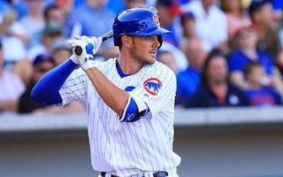
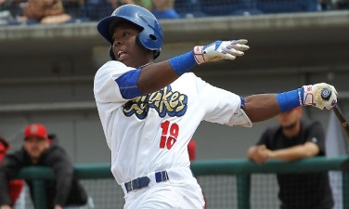
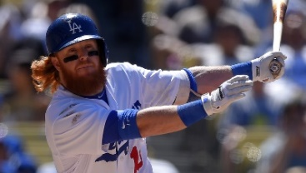
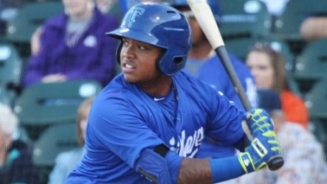
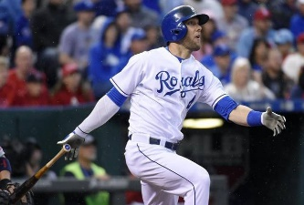
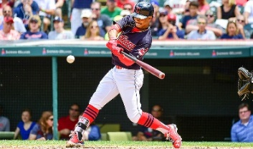
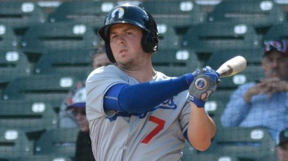
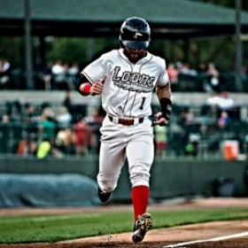
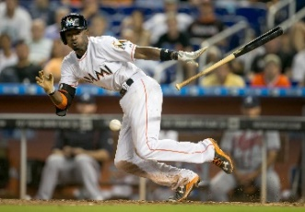
ISO: Isolated Power
Elite
Elite
Justin Turner: .218
Willie Calhoun: .215 (AA)
Kris Bryant: .262
Johan Mieses: .262 (A+)
Alex Gordon: .160
ML AVERAGE: .162
ML AVERAGE: .162
Saige Jenco: .088 (A)
Dee Gordon: .068
Kyle Farmer: .139 (AA)
Francisco Lindor: .134
Poor
Poor

Slide 10
wOBA: Weighted On-Base Average
Description: Weighted on Base Average is a more advanced version of OPS. In OPS and Slugging%, each outcome is assigned a value equal to their base (single or walk = 1, double = 2, etc.). wOBA assigns an adjusted run value to each outcome that better represents the average value of that result to the batting team’s chances of scoring runs. wOBA is on the same scale as On-Base Percentage (OBP).
Why it’s Important: wOBA is one of the most important and popular publically available catch-all offensive statistics that attempts to measure a player’s overall offensive value. If you could only look at 1 offensive statistic of a player, this would be a good choice.
Why it Doesn’t Tell Us the Whole Picture: wOBA on most publicly available websites is not adjusted for park effects, meaning that batters that play in hitter-friendly parks will have slightly inflated wOBAs.

Slide 11
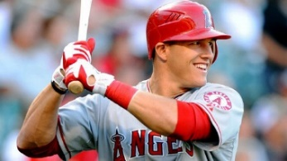
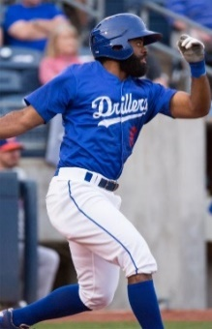

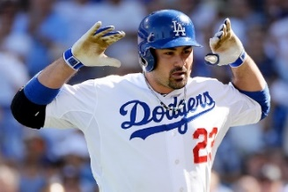
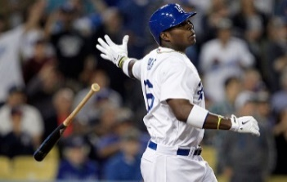
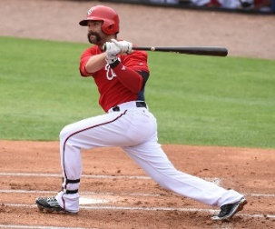
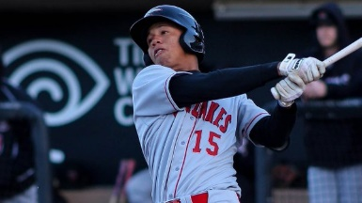
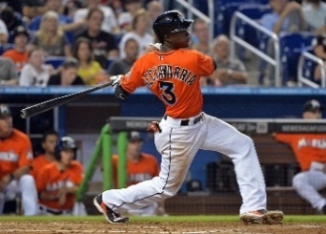
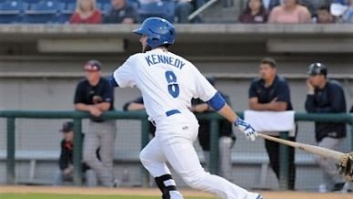
wOBA: Weighted On-Base Average
Elite
Elite
Adrian Gonzalez: .334
Mike Trout: .418
Andrew Toles: .389 (AA)
Willie Calhoun: .348 (AA)
ML AVERAGE: .318
ML AVERAGE: .318
Yasiel Puig: .320
Garrett Kennedy: .243 (A+)
Danny Espinosa: .294
Ariel Sandoval: .285 (A+)
Poor
Adeiny Hechavarria: .256
Poor

Slide 12
wRC+: Weighted Runs Created Plus
Description: wRC+ is very similar to wOBA, but it is scaled to 100 where 100 is league average for that season in those ballparks. If a player or team’s wRC+ is 107, that means that his offensive production was worth 7% more runs than the league average hitter, after accounting for the parks he played in. For example, in 2015, Andrew McCutchen had an .889 OPS which translated to a 146 wRC+, while Nolan Arenado had an .898 OPS which translated to a 119 wRC+ because of the parks they played in (PNC vs. Coors).
Why it’s Important: Along with wOBA, wRC+ is one of the most important and popular publically available catch-all offensive statistics that attempts to measure a player’s overall offensive value. If you could only look at 1 offensive statistic of a player, this would be a good choice.
Why it Doesn’t Tell Us the Whole Picture: wRC+ is only indicative of a player’s season-to-date offensive performance. Thus, it doesn’t necessarily factor luck into account. Therefore, it is not necessarily predictive of future performance. For example, if a player is batting .400 due in part to an astronomical BABIP, just like we could expect his batting average to regress because of his high BABIP, we could expect his wRC+ to regress as well.

Slide 13
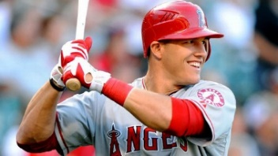
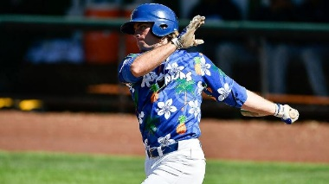

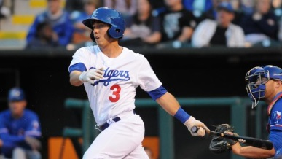
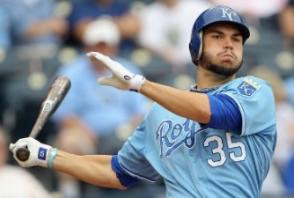
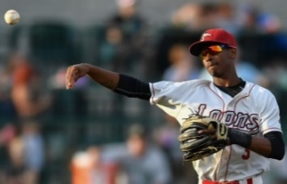
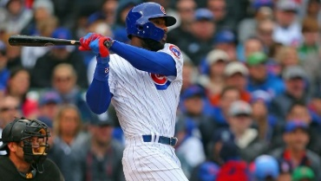
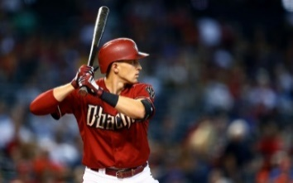
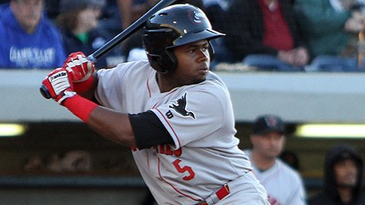
wRC+: Weighted Runs Created
Elite
Elite
Mike Trout: 171
DJ Peters: 161 (SA)
Justin Turner: 124
Austin Barnes: 123 (AAA)
ML AVERAGE: 100
ML AVERAGE: 100
Eric Hosmer: 101
Brendon Davis: 86 (A)
Jason Heyward: 72
Poor
Nick Ahmed: 42
Cristian Gomez: 41 (A)
Poor

Slide 14
Exit Velocity
Description: The average speed, in MPH, of batted balls in play.
Why it’s Important: Generally speaking, harder contact equates to a higher chance any given batted ball has at becoming a hit and doing considerable damage.
Why it Doesn’t Tell Us the Whole Picture: While there is a solid correlation between average exit velocity and offensive production, it is far from perfect. While it is safe to assume that on average, hitting a batted ball harder is a good thing, there are still plenty of productive major leaguers with below average exit velocities who do other things well (decision making/plate discipline, bat to ball ability, etc.). If anything, high exit velocity might be more indicative of a given player’s ability to hit for power rather than a given player’s overall offensive production.

Slide 15
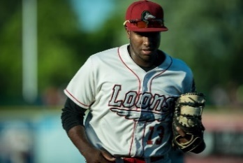
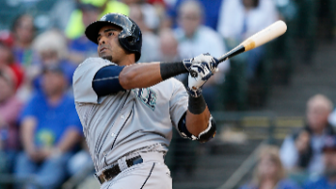


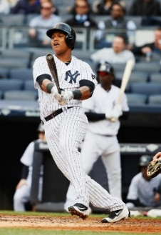
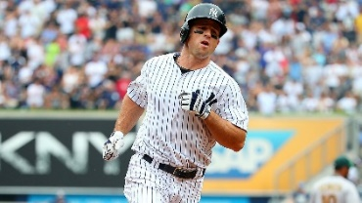
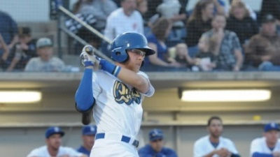
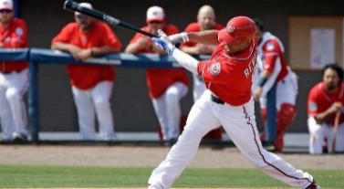

Exit Velocity
Elite
Elite
Nelson Cruz: 95.7
Ibandel Isabel: 97
Cody Bellinger: 93
Justin Turner: 90.9
ML AVERAGE: 89.2
ML AVERAGE: 89.2
Starlin Castro: 89.1
Brett Gardner: 86.9
Matt Beaty: 86
Poor
Poor
Ben Revere: 83.7
Tim Locastro: 83

Slide 16
Swing%: Swing Rate
Description: The percentage of pitches that are swung at.
Why it’s Important: Swing rate is indicative of a given batter’s aggressiveness and can lend valuable insight when game planning how to pitch to a given batter.
Why it Doesn’t Tell Us the Whole Picture: Swing% does not tell us how often a given player swings at pitches inside the strike zone versus how often he swings outside of the strike zone. Thus, while these are generally correlated, Swing% does not necessarily distinguish plate discipline and aggressiveness. Furthermore, it does not tell us anything about the outcome of the swing.

Slide 17
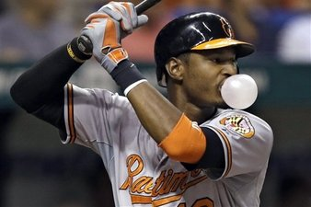
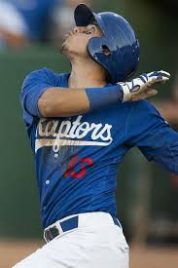







Swing%: Swing Percentage
High
High
Adam Jones: 60.4%
Gersel Pitre: 59.9%
Johan Mieses: 54.0%
Corey Seager: 52.5%
ML AVERAGE: 46.7%
ML AVERAGE: 46.7%
Buster Posey: 46.7%
Joey Votto: 41.5%
Austin Barnes: 40.5%
Ben Zobrist: 35.5%
Steve Berman: 37.4%
Low
Low

Slide 18
zSwing%: In-Zone Swing Rate
Description: The percentage of pitches that are swung at inside of the zone
Why it’s Important: zSwing% is indicative of a given batter’s aggressiveness within the strike zone and can lend valuable insight when game planning how to pitch to a given batter.
Why it Doesn’t Tell Us the Whole Picture: zSwing% does not give us a comprehensive outlook on a player’s overall aggressiveness. A player might swing aggressively within the zone, but also display tremendous plate discipline and have a very low chase rate. Furthermore, it does not tell us anything about the outcome of the swing.

Slide 19







zSwing%: In-Zone Swing Percentage
High
High
Adam Jones: 81.9%
Andrew Toles: 80.7%
Kris Bryant: 72%
Omar Estevez: 72.6%
ML AVERAGE: 65.6%
ML AVERAGE: 65.6%
Evan Longoria: 65.5%
Kyle Farmer: 61.3%
Dustin Pedroia: 60%
Ben Zobrist: 55.2%
Low
Low
Jack Murphy: 53.7%

Slide 20
Chase%: Chase Rate (oSwing%)
Description: The percentage of pitches in which a given batter swung at outside of the strike zone.
Why it’s Important: Chase rate gives us an indication of a given player’s plate discipline and understanding of the strike zone. Generally speaking, a player more likely to chase is more likely to struggle offensively because generally speaking, it is harder to hit pitches outside of the strike zone well. Furthermore, it can lend valuable insight when game planning how to pitch a given batter.
Why it Doesn’t Tell Us the Whole Picture: Chase rate does not take into account the result of the play. Thus, a player might have a high chase rate but also might exhibit tremendous bat-to-ball skills and make contact at an above average clip as well. For example, while Jose Altuve has averaged a high chase rate throughout his career (33.1%), he has performed at an elite offensive level over that span. Thus, while a high chase rate is certainly not ideal, it does not necessarily mean a player cannot be productive offensively (ex: Vladimir Guerrero).

Slide 21









Chase%: Chase Percentage
High
High
Javier Baez: 41.1%
Edwin Rios: 36.9%
Carlos Gonzalez: 33.7%
Brendon Davis: 33.1%
ML AVERAGE: 28.1%
ML AVERAGE: 28.1%
Freddie Freeman: 28.4%
Saige Jenco: 15.6%
Yasmani Grandal: 22.2%
Cody Bellinger: 22.5%
Low
Joey Votto: 18.2%
Low

Slide 22
Contact%: Contact Rate
Description: The percentage of swings on which batters make contact (including foul balls).
Why it’s Important: Contact% is a good indication of a player’s bat-to-ball skills. Especially within PD, it is useful because it can be an indication of how a player might fare moving up through the minor league levels. If a player has a slightly below average contact rate in High-A, a fair criticism might be that his contact rate is likely to continue to decrease as he faces better competition. A high contact rate usually corresponds to a low strikeout rate and vice versa.
Why it Doesn’t Tell Us the Whole Picture: Contact rate tells us nothing about the type of contact a given batter is making. Thus, a player can have a solid contact rate, but if he isn’t doing any damage and doesn’t have the speed to make up for it, he likely is not a productive offensive player.

Slide 23









Contact%: Contact Percentage
High
High
Daniel Murphy: 88%
Willie Calhoun: 86.8%
Francisco Lindor: 82.9%
Tim Locastro: 83.1%
ML AVERAGE: 76.4%
ML AVERAGE: 76.4%
Corey Seager: 76.7%
Ibandel Isabel: 48.2%
Justin Upton: 69.2%
Johan Mieses: 66.9%
Low
Chris Davis: 62.9%
Low

Slide 24
GB%: Ground Ball Rate
Description: The percentage of ground balls per batted balls in play
Why it’s Important: A high ground ball rate for a batter is not desirable because ground balls are much less likely to cause damage than line drives and fly balls.
Why it Doesn’t Tell Us the Whole Picture: A batter can have a high ground ball rate and still be successful if they have elite contact skills and speed as well.

Slide 25





GB%: Groundball Percentage
High
High
Francisco Lindor: 50%
Howie Kendrick: 61.4%
Erick Mejia: 55.2% (A+)
Brendon Davis: 52.8% (A)
ML AVERAGE: 45.9%
ML AVERAGE: 45.9%
Tim Locastro: 40.7% (A+)
Daniel Murphy: 37.6%
Brandon Belt: 27.4%
Cody Bellinger: 29.8% (AA)
Low
Low

Slide 26
PU%: Pop-Up Rate
Description: The percentage of pop-ups per batted balls in play
Why it’s Important: A high pop-up rate for a batter is not desirable because pop-ups are essentially guaranteed outs and are the next worst outcome for a hitter after a strikeout.
Why it Doesn’t Tell Us the Whole Picture: A batter can have a high PU% and still be effective if he pairs it with elite power, contact skills, or plate discipline.

Slide 27






PU%: Pop-up Percentage
Poor
Poor
Todd Frazier: 14.7%
Willie Calhoun: 13.5% (AA)
Adam Duvall: 9.9%
Jacob Scavuzzo: 10.2% (AA)
ML AVERAGE: 6.9%
ML AVERAGE: 6.9%
Ryan Braun: 4.3%
Kyle Garlick: 4.2% (AA)
Elite
Joey Votto: 1.4%
Elite

Slide 28
Hitter Profile: Chris Davis
wRC+ in 2016: 111
K%
BB%
ISO
Poor
Elite
Elite
Chris Davis: 32.9%
Chris Davis: .279
Chris Davis: 13.2%
ML AVERAGE: 21.1%
ML AVERAGE: 8.2%
ML AVERAGE: .162
Elite
Poor
Poor

Slide 29

Hitter Profile: Yasmany Tomas
wRC+ in 2016: 109
K%
BB%
ISO
Poor
Elite
Elite
Yasmany Tomas: 24.2%
Yasmany Tomas: .236
ML AVERAGE: 21.1%
ML AVERAGE: .162
ML AVERAGE: 8.2%
Yasmany Tomas: 5.5%
Elite
Poor
Poor

Slide 30

Hitter Profile: Martin Prado
wRC+ in 2016: 109
K%
BB%
ISO
Poor
Elite
Elite
ML AVERAGE: 8.2%
ML AVERAGE: .162
ML AVERAGE: 21.1%
Martin Prado: 7.4%
Martin Prado: .112
Martin Prado: 10.5%
Elite
Poor
Poor

Slide 31
Pitcher Statistics

Slide 32
K%: Strikeout Rate
Description: The percentage of plate appearances that result in a strikeout
Why it’s Important: More plate appearances resulting in strikeouts means less balls being put in play. Less balls being put in plays means less opportunities for an opposing batter to reach base. Thus, a strikeout is the most valuable outcome for a pitcher in any given plate appearance.
Why it Doesn’t Tell Us the Whole Picture: A pitcher’s strikeout rate only gives us an idea for his ability to miss bats. While having a high strikeout rate makes it a lot easier to be successful, a pitcher can still have a high K% and not be effective if it is paired with poor command and a propensity to give up hard contact (Home Runs). Additionally, pitchers with low strikeout rates can be successful by throwing a ton of strikes and limiting damage/home runs (high GB%).

Slide 33








K%: Strikeout Rate
Starters
Relievers
Elite
Elite
Andrew Miller: 44.7%
Corey Kluber: 26.4%
Clayton Kershaw: 31.6%
Reliever Average: 22.7%
Mychal Givens: 30.7%
ML AVERAGE: 21.1%
ML AVERAGE: 21.1%
Starter Average: 20.2%
Travis Wood: 18.7%
Josh Tomlin: 16.3%
Jeanmar Gomez: 15.8%
Doug Fister: 14.8%
Poor
Poor

Slide 34




K%: Strikeout Rate
Elite
Elite
Dennis Santana: 26.4% (A)
Corey Kluber: 26.4%
Clayton Kershaw: 31.6%
Yadier Alvarez: 34.6% (A)
ML AVERAGE: 21.1%
Chase De Jong: 22.2% (AA)
Trevor Oaks: 18.8% (AAA)
Josh Tomlin: 16.3%
Doug Fister: 14.8%
Poor
Poor

Slide 35
BB%: Walk Rate
Description: The percentage of plate appearances that result in a walk
Why it’s Important: Low walk rates are good for pitchers because less baserunners = less opportunities for opposing offenses to score runs. Generally speaking, a pitcher’s walk rate is also indicative of his overall command.
Why it Doesn’t Tell Us the Whole Picture: A pitcher can have a high walk rate and still be effective on the mound. However, a pitcher with a high walk rate must also be missing bats at an above average clip and/or inducing weak contact to compensate for their tendency to put guys on base. Conversely, a pitcher with a low walk rate who gets hit really hard is likely to still have struggles on the mound.

Slide 36






BB%: Walk Rate
Starters
Relievers
Poor
Poor
Craig Kimbrel: 13.6%
Jake Arrieta: 9.6%
Francisco Liriano: 11.6%
Mychal Givens: 11.5%
Reliever Average: 9.0%
ML AVERAGE: 8.2%
ML AVERAGE: 8.2%
Starter Average: 7.7%
Zach Britton: 7.1%
Zack Greinke: 6.2%
Clayton Kershaw: 2%
Kenley Jansen: 4.4%
Elite
Elite

Slide 37



BB%: Walk Rate
Starters
Relievers
Poor
Poor
Jake Arrieta: 9.6%
Francisco Liriano: 11.6%
Dennis Santana: 11.9%
Mitchell White: 10.3% (A)
ML AVERAGE: 8.2%
ML AVERAGE: 8.2%
Zack Greinke: 6.2%
Clayton Kershaw: 2%
Imani Abdullah: 4.1% (A)
Elite
Elite
Brock Stewart: 3% (AAA)

Slide 38
FPS%
Description: The percentage of first pitches that were strikes
Why it’s Important: A pitcher’s ability to throw strike 1 is invaluable. Statistically, it tips the plate appearance considerably in the pitcher’s favor and a high FPS% is usually indicative of a pitcher’s ability to command the strike zone.
Why it Doesn’t Tell Us the Whole Picture: FPS% only gives us an idea for a pitcher’s propensity to throw strikes. If a pitcher has poor stuff and has an inability to miss bats, then regardless of his ability to command the strike zone he is unlikely to be successful at the major league level.

Slide 39






FPS%: First Pitch Strike Percentage
Elite
Elite
Noah Syndergaard: 63.6%
Imani Abdullah: 63.0% (A)
Kyle Hendricks: 68.4%
Brock Stewart: 68.9%
ML AVERAGE: 60.2%
ML AVERAGE: 60.2%
Oscar Arzaga: 50.6% (R)
Danny Salazar: 53.8%
Cole Hamels: 57.4%
Josh Sborz: 56.8%
Poor
Poor

Slide 40
Zone%
Description: The percentage of pitches that were in the strike zone (including pitches that are hit).
Why it’s Important: A pitcher’s Zone% on a given pitch—or their collective repertoire—is indicative of his control and/or aggressiveness with that pitch(es).
Why it Doesn’t Tell Us the Whole Picture: Zone% tells us nothing about the effectiveness/quality of a pitcher’s pitches. It also does not tell us anything about the result of those pitches. A pitcher may be working out of the zone effectively (generating chases) or ineffectively (missing for balls).

Slide 41






Zone%: In Zone Percentage
Starters
Relievers
Elite
Elite
Hisashi Iwakuma: 52.9%
Oliver Perez: 53.5%
Kenley Jensen: 59.5%
Rich Hill: 56.5%
ML AVERAGE: 49.8%
Starter Average: 50.0%
ML AVERAGE: 49.8%
Reliever Average: 49.6%
Brad Ziegler: 42%
Jon Lester: 46.3%
Mike Montgomery: 45.9%
Francisco Liriano: 43.4%
Poor
Poor

Slide 42


Zone%: In Zone Percentage
Elite
Elite
Hisashi Iwakuma: 52.9%
Brock Stewart: 59.6% (AAA)
Rich Hill: 56.5%
Caleb Ferguson: 54% (A)
ML AVERAGE: 49.8%
ML AVERAGE: 49.8%
Dennis Santana: 42% (A)
Jon Lester: 46.3%
Nolan Long: 45.3% (A)
Francisco Liriano: 43.4%
Poor
Poor

Slide 43
Miss%
Description: The percentage of batters’ swings that resulted in a swing and miss.
Why it’s Important: Miss rate gives us a solid idea for how unhittable a pitcher’s raw stuff is.
Why it Doesn’t Tell Us the Whole Picture: While miss rate tells us how many times batters swung and missed per total number of swings for a given pitcher, it doesn’t give us an idea for the total of number of pitches that batters swung and missed at. Thus, it doesn’t necessarily give us a clear idea of how deceptive a pitcher is. It is more useful as an indication of how unhittable a pitcher’s raw stuff is.

Slide 44







Miss%: Miss Percentage
Starters
Relievers
Elite
Elite
Dellin Betances: 41.1%
Cody Allen: 31.2%
Corey Kluber: 28.1%
Max Scherzer: 32.4%
Reliever Average: 25.5%
ML AVERAGE: 23.6%
ML AVERAGE: 23.6%
Starter Average: 22.4%
Javier Lopez: 16.2%
Pat Neshek: 23.1%
Ross Stripling: 20.2%
Bartolo Colon: 13.6%
Poor
Poor

Slide 45



Miss%: Miss Percentage
Elite
Elite
Yadier Alvarez: 31.8% (A)
Corey Kluber: 28.1%
Max Scherzer: 32.4%
ML AVERAGE: 23.6%
Julio Urias: 28.8% (AAA)
ML AVERAGE: 23.6%
Ross Stripling: 20.2%
Bartolo Colon: 13.6%
Chase De Jong: 22.4 (AA)
Imani Abdullah: 21.4% (A)
Poor
Poor

Slide 46
SwStrk%
Description: The percentage of total pitches that resulted in a swing and miss.
Why it’s Important: Swinging Strike% gives us a very solid general idea of how difficult to hit and deceptive a given pitcher’s stuff is.
Why it Doesn’t Tell Us the Whole Picture: Swinging Strike percentage gives us a very good idea for how good a pitcher’s general stuff is. However, it doesn’t necessarily isolate the leading reason as much as other metrics might. For example, miss rate (also called whiff rate) might be more a more useful metric if you’re looking to get an idea for how good a pitcher’s raw stuff is (miss rate measures swings and misses over swings instead of total pitches. It’s more indicative of a pitcher’s raw stuff because it measures the percentage a given player swung and missed after deciding to swing). And chase rate might be a more useful metric if you’re looking to get an idea for how deceptive a given pitcher is (because it measures how often a given batter swung at pitches outside of the zone, it can be indicative of a pitcher’s ability to cause guys to chase). SwStr% is a more general and comprehensive blend of the two.

Slide 47




SwStrik%: Swinging Strike Percentage
Starters
Relievers
Elite
Elite
Aroldis Chapman: 19.8%
Justin Verlander: 13.5%
Clayton Kershaw: 16.3%
Pedro Strop: 16.3%
Reliever Average: 12.0%
ML AVERAGE: 11.0%
ML AVERAGE: 11.0%
Starter Average: 10.4%
J.P. Howell: 9.5%
Ross Stripling: 8.5%
Javier Lopez: 7.0%
Doug Fister: 6.3%
Poor
Poor

Slide 48



SwStrik%: Swinging Strike Percentage
Elite
Elite
Justin Verlander: 13.5%
Brock Stewart: 13.4% (AAA)
Clayton Kershaw: 16.3%
Walker Buehler: 15.7% (A)
ML AVERAGE: 11.0%
ML AVERAGE: 11.0%
Andrew Sopko: 9.2% (A+)
Trevor Oaks: 10.1% (AAA)
Ross Stripling: 8.5%
Doug Fister: 6.3%
Poor
Poor

Slide 49
GB%: Ground Ball Rate
Description: The percentage of ground balls per batted balls in play
Why it’s Important: A high ground ball rate is desirable because ground balls are much less likely to cause damage than line drives and fly balls.
Why it Doesn’t Tell Us the Whole Picture: A pitcher can have a high GB% and still not be effective if they also let up frequent, hard contact, and/or they walk a lot of guys. A pitcher can have a low ground ball rate and still be effective by missing bats, throwing a lot of strikes, and/or inducing weak contact.

Slide 50









GB%: Groundball Percentage
Relievers
Starters
Elite
Elite
Zach Britton: 80.2%
Johnny Cueto: 52.2%
Blake Treinen: 66.9%
Marcus Stroman: 61.6%
Reliever Average: 46.6%
Mark Melancon: 55.5%
ML AVERAGE: 46.2%
ML AVERAGE: 46.2%
Starter Average: 45.9%
Chris Sale: 42.2%
Ken Giles: 41.4%
Jered Weaver: 29.6%
Poor
Poor
Koji Uehara: 26.9%

Slide 51
GB%: Groundball Percentage
Elite
Elite
Johnny Cueto: 52.2%
Julio Urias: 53.6% (AAA)
Marcus Stroman: 61.6%
Trevor Oaks: 58.4% (AAA)
ML AVERAGE: 46.2%
ML AVERAGE: 46.2%
Chris Sale: 42.2%
Imani Abdullah: 39.0%
Chase De Jong: 37.6% (AA)
Jered Weaver: 29.6%
Poor
Poor

Slide 52
PU%: Pop-Up Rate
Description: The percentage of pop-ups per batted balls in play
Why it’s Important: A high pop-up rate is desirable because pop-ups are much less likely to cause damage than line drives and fly balls. Pop-ups are outs almost every single time. They are the next most valuable outcome to strikeouts for a pitcher. Generally speaking, pitchers that have high PU% are generating weak contact. Thus, pitcher’s with consistently high PU% tend to outperform their FIPs because of their ability to induce weak contact (ex: Hector Santiago).
Why it Doesn’t Tell Us the Whole Picture: A pitcher can have a high PU% and still not be effective if they exhibit poor command and have a propensity to give up home runs.

Slide 53





PU%: Pop-up Percentage
Elite
Elite
Leo Crawford: 16.0% (A)
Jake Odorizzi: 10.0%
Max Scherzer: 13.5%
Imani Abdullah: 9.9% (A)
ML AVERAGE: 7%
ML AVERAGE: 7%
Josh Tomlin: 5.1%
Yadier Alvarez: 4.3% (A)
Mike Leake: 3.0%
Trevor Oaks: 2.5% (AAA)
Poor
Poor

Slide 54
FIP
Description: Fielding Independent Pitching (FIP) is designed to evaluate pitcher performance based on things the pitcher can control: K, BB, HR, and HBP. It uses those 4 statistics to predict ERA if all other results were average. FIP is modeled after ERA.
Why it’s Important: Ultimately, we want to use statistics that allow us to isolate the performance of the player we are attempting to analyze. FIP is important because it is a measurement of a pitcher’s performance that strips out the role of defense, luck, and sequencing, making it a more stable indicator of how a pitcher actually performed over a given period of time than a pitcher’s ERA. In other words, FIP does a better job than ERA of isolating a pitcher’s performance and illustrating how good he is at controlling the things he can control.
Why it Doesn’t Tell Us the Whole Picture: FIP is not park adjusted and does not factor in GB% like SIERA does or give credit for weak contact (i.e. PU%).

Slide 55





FIP: Fielding Independent Pitching
Elite
Elite
Yadier Alvarez: 1.85 (A)
Noah Syndergaard: 2.29
Brock Stewart: 2.97 (AAA)
David Price: 3.60
ML AVERAGE: 4.19
ML AVERAGE: 4.19
Ian Kennedy: 4.67
Zach Lee: 4.73 (AAA)
Chris Anderson: 5.93 (AA)
Poor
Jered Weaver: 5.62
Poor

Slide 56
Extension
Description: Trackman data point measuring the distance from the mound to the pitcher’s point of release. MLB average is around 6 feet. Extension can vary from 4.5 ft to 7.5 ft in the most extreme cases. Generally, a pitcher will have different extension measures by pitch type.
Why it’s Important: A pitcher’s extension can have a profound impact on the effectiveness of a pitch. For example, Kenley Jansen’s elite extension (7.34) adds a perceived 2-3 MPH on the pitch from a hitter’s perspective.
Why it Doesn’t Tell Us the Whole Picture: All extension tells us is what the “effective velocity” is. Velocity or effective velocity are only a factor that plays a role in a given pitcher’s success—or lack thereof.

Slide 57


Extension (FB)
Starters
Relievers
Elite
Elite
Dustin May: 6.5
Kenley Jansen: 7.34
Imani Abdullah: 6.8
ML AVERAGE: 6.17
Clayton Kershaw: 6.48
ML AVERAGE: 6.17
Chris Archer: 5.97
Trevor Oaks: 6.1
Dennis Santana: 5.6
Bartolo Colon: 5.29
Poor
Poor

Slide 58
Exit Velocity
Description: The average speed, in MPH of batted balls in play.
Why it’s Important: Generally speaking, harder contact equates to a higher chance any given batted ball has at becoming a hit and doing considerable damage.
Why it Doesn’t Tell Us the Whole Picture: While it is safe to assume that giving up hard contact is bad for pitchers, there are still productive major league pitchers with above average exit velocities. If a pitcher can also produce a high strikeout rate, low walk rate, etc., he can still be successful despite giving up harder contact.

Slide 59



Exit Velocity
Poor
Archie Bradley: 90.1
Phil Hughes: 92.7
ML AVERAGE: 89.2
ML AVERAGE: 89.2
Johnny Cueto: 88.4
Kenta Maeda: 86.2
Elite

Slide 60

Pitcher Profile: Craig Kimbrel
FIP in 2016: 2.92
K%
BB%
GB%
PU%
Elite
Poor
Elite
Elite
Craig Kimbrel: 13.6%
Craig Kimbrel: 37.7%
Craig Kimbrel: 11.7%
ML AVERAGE: 21.1%
ML AVERAGE: 8.2%
ML AVERAGE: 46.2%
ML AVERAGE: 7.0%
Craig Kimbrel: 31.1%
Poor
Elite
Poor
Poor

Slide 61

Pitcher Profile: Mike Leake
FIP in 2016: 3.83
K%
BB%
GB%
PU%
Elite
Poor
Elite
Elite
Mike Leake: 55.1%
ML AVERAGE: 21.1%
ML AVERAGE: 8.2%
ML AVERAGE: 46.2%
ML AVERAGE: 7.0%
Mike Leake: 16.5%
Mike Leake: 3.0%
Mike Leake: 4.0%
Poor
Elite
Poor
Poor

Slide 62

Pitcher Profile: Hector Santiago
K%
BB%
GB%
PU%
Elite
Poor
Elite
Elite
ML AVERAGE: 46.2%
Hector Santiago: 13.5%
ML AVERAGE: 7.0%
ML AVERAGE: 21.1%
ML AVERAGE: 8.2%
Hector Santiago: 10.1%
Hector Santiago: 18.3%
Hector Santiago: 34.1%
Career FIP: 4.73
Career ERA: 3.84
Poor
Elite
Poor
Poor

